Slide 1
EXPENDITURE ANALYSIS FOR TRACKING THE PROCUREMENT OF FIXED ASSETS
GSM function required: BI (BUSINESS INTELLIGENCE)

Slide 2
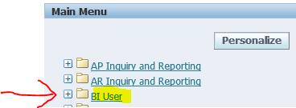
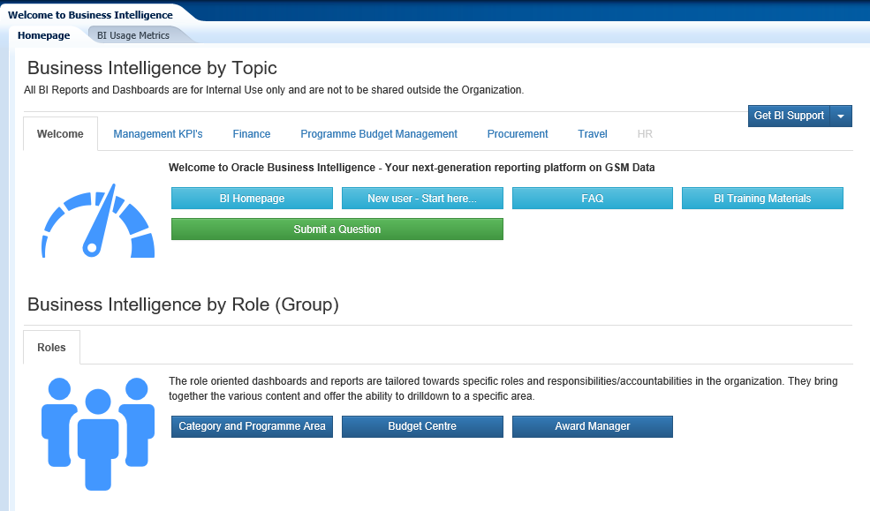
1. select GSM function BI User,
2. This takes the user to the BI Interface page

Slide 3
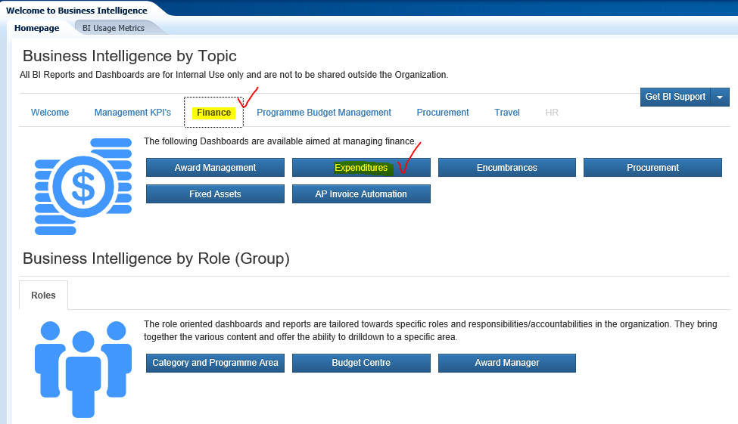
3. select FINANCE
then EXPENDITURE

Slide 4
4. select FINANCE
then EXPENDITURE

Slide 5
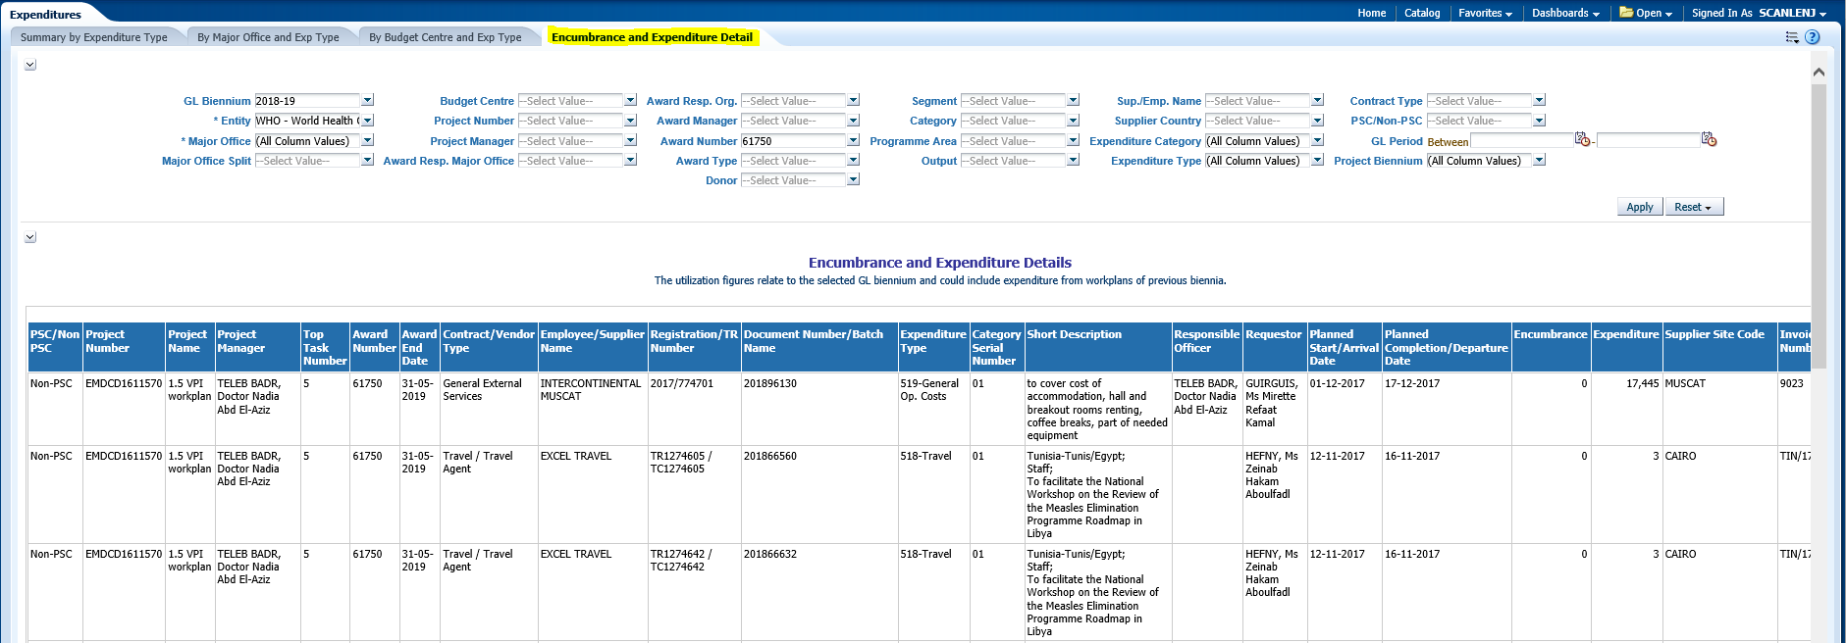
5. select
ENCUMBRANCE AND EXPENDITURE DETAIL

Slide 6
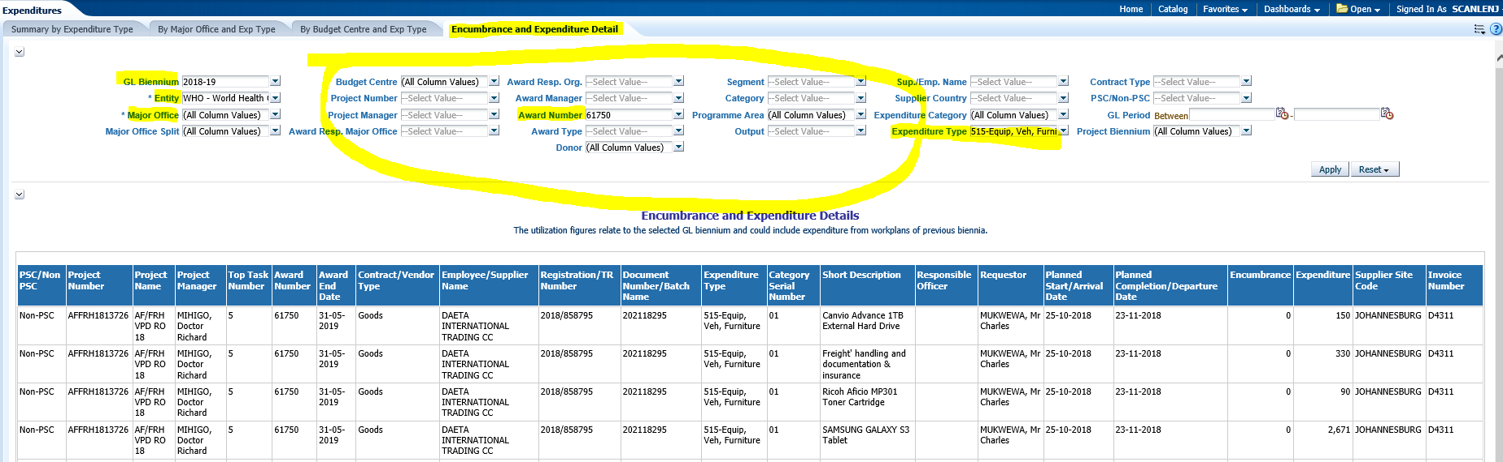
6. KEY FILTERS
GL Biennium
Major Office
Award Number – default setting is 61750, select all awards if required
Expenditure Type 515 - Equipment

Slide 7
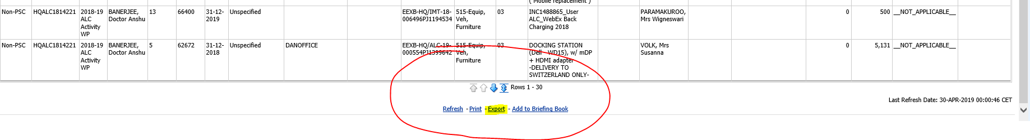
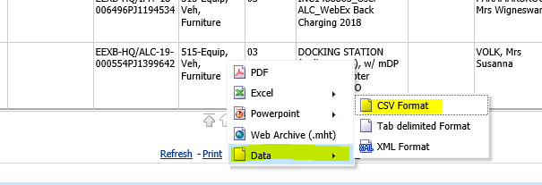
7. EXPORTING THE RESULTS
SCROLL TO THE END OF THE PAGE
select EXPORT
DATA
CSV FORMAT
…..then wait a minute for the report to be generated.
By selecting .csv file all columns will be displayed and the file can then be “saved as” in EXCEL format

Slide 8
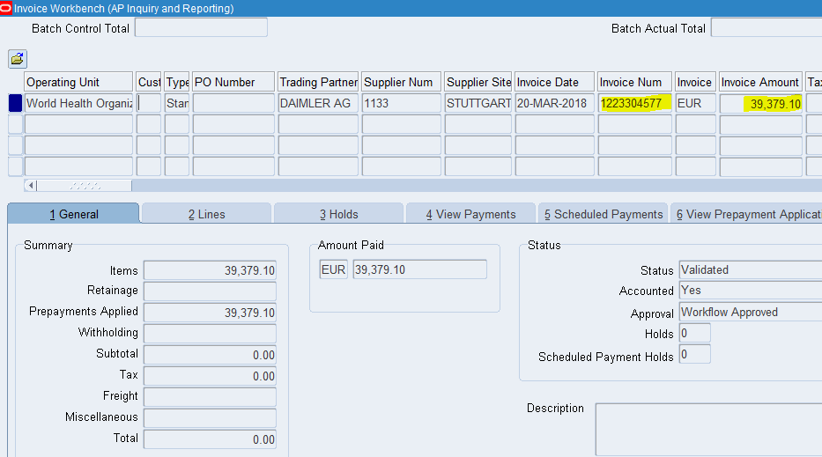
Select:
Holds or View Payments to see the status of the payment.

